Slide 1

BUS 312 June at the Multiplex Case
Data Analysis – Diagnostic Analytics
(theory and practice)
Wayne Smith, Ph.D.
Department of Management
CSU Northridge
ws@csun.edu

Slide 2
Introduction/Overview
We want to know what’s “true”, “best”, or “correct”.
  Case: Is Tammy an outlier or is she more like the typical moviegoer?
To do that, we need to understand “uncertainty”.
  Case: We, as analysts to help Ms. Plex, acknowledge that uncertainty is everywhere, and we need to deal with that uncertainty as best we can.
To do that, we need to “control for”, “rule out”, or “understand” randomness, and we know that randomness is related to probability.
  Case: We took two surveys from a sample. Any sample, even a well-designed one, is not the population. And it’s the population for which we are trying to make an inference. We infer from the sample to the population.
We don’t want any “errors”, “omissions”, or “bad decisions” due to randomness (that is, we don’t want to be “fooled by randomness”).
  Case: Ms. Plex needs to make decision: defend the proposed class-action lawsuit or settle the class-action lawsuit. Naturally, neither Ms. Plex nor any other stakeholder wants to be wrong.

Slide 3
Preliminary Questions
Of all the possible questions, what’s the single, most important question?
  Case: Do moviegoers resent the advertising/trailers before each movie?
Is the result of that question a continuous variable or a discrete variable?
  Case: Discrete (that is, the response from the respondent is “yes” or “no”)
Is the summary of a discrete variable a mean or a proportion?
  Case: Proportion (that is, a percentage).
What is the correct method to graph a proportion (or percentage)?
  Case: Bar (better) or Pie (acceptable)
How do we know if the sample proportion is representative of the population proportion?
  Case: Do a hypothesis test (to rule out, or understand, randomness)
There are many hypothesis tests. Which one is the correct one?
  Case: a one-sample proportion test using the binomial distribution
  (or equivalently, in this case with large n’s, it’s a bit easier to just use the normal approximation to the binomial: that is, the Z-test

Slide 4
Summary Data
 | Sample 1 | Sample 2
x (resent?) (“yes”) | 190 | 145
n (sample size) | 1377 | 1166
p-hat (proportion) | 0.1379 | 0.1243
p-hat (percentage) | 13.79% | 12.43%
Given: significance level “alpha” (α = 0.05)
Meaning: We are willing to be wrong 0.05 or $\frac{5}{100}$ or $\frac{1}{20}$ times.
Source: Excel Data file on the instructor’s course outline web page

Slide 5
Decision Rule – Defend or Settle?
Resent
(Don’t
Like)
the Ads
Don’t
Resent
(Like)
the Ads
proportion (percentage) of Responses
0%
100%
Ms. Plex’s cut-off (break) point (15%)
Sample #1 (13.79%)
Sample #2 (12.43%)
Source: Case Text and Case Data
Note: not to scale

Slide 6
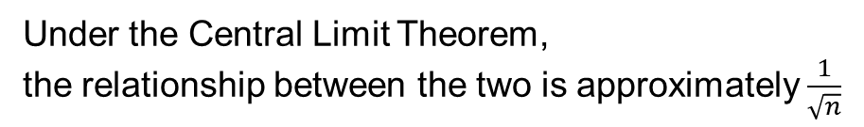
Relationship between a population and a sample
Population
(e.g., all moviegoers)
Sample
(e.g., some
moviegoers)
Under the Central Limit Theorem,
the relationship between the two is approximately $\frac{1}{\sqrt{n}}$

Slide 7
Hypothesis Test
The Null Hypothesis H₀ (the random scenario)
  Case: H₀: p ≥ 15%
The Alternate Hypothesis H_{a} (the scenario that might not be random)
  Case: H_{a}: p < 15%
A one-tailed test can be used here although a two-tailed test could also be used here and is a slightly stronger test (also, remember that the equal sign goes in the Null Hypothesis).
  Case: Ms. Plex is really only interested in “one side” of the distribution.
Using data and a one-sample proportion test, we can try to see if we can reasonably reject the Null Hypothesis.
  Case: Ms. Plex would like to know if Tammy is an outlier.

Slide 8
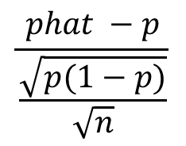
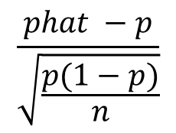
Compute the test statistic
In English:
Sample proportion minus the (Hypothesized) Population proportion
(
)
Sample standard deviation of proportion
Relationship between sample and proportion
In Math:
$$\frac{phat −p}{\frac{\sqrt{p(1−p)}}{\sqrt{n}}}$$
test statistic =
With
Some
Algebra:
$$\frac{phat −p}{\sqrt{\frac{p(1−p)}{n}}}$$
test statistic =
Source: Wikipedia

Slide 9

Evaluation—“Distance Along the Line” Method
We compare the test statistic with the critical value.
That is, we see how “far” the test statistic is away from zero.
If test statistic is to the left of the critical value, then reject H₀; else we accept H₀.
“Accept” (the H₀)
“Reject”
(the H₀)
Critical Value
Can be computed in Excel:
=NORM.S.INV(alpha)

Slide 10
Evaluation—“Area Under the Curve” Method
We compare the P(test statistic) with the significance level (α = 0.05).
That is, we see how much “space” the test statistic takes up of the distribution.
If the area of the P(test statistic) is less than the α, then reject H₀; else we accept H₀.
“Accept” (the H₀)
“Reject”
(the H₀)
P(test statistic)
Can be computed in Excel:
=NORM.S.DIST(test statistic, TRUE)

Slide 11
Confidence Interval Equation
In English:
Population (true) proportion equals
Sample (estimate) proportion
plus or minus P(Z alpha/2) times (sample sd. / sqrt(n))
In Math:
Note: P(Z_{α/2}) can be computed in Excel:
=NORM.S.INV(alpha/2)
Source: Wikipedia

Slide 12
Shrewd Spreadsheeting
Consider starting with the Excel workbook on the web page
  It already has the data, and …
  You can add anything you like with new worksheets
Try to do everything for Sample #1 first
  Then, you can “copy-and-paste” the existing Sample #1 worksheet(s) to a new Sample #2 worksheet(s), and…
  Edit just the top of the new spreadsheet(s) to change the sample percentage (x), sample size (n), and…
  Review the bottom of the new spreadsheet(s) to check for any changes in results (that is, “reject H₀” or “accept H₀”, or a wider or narrower confidence interval

Slide 13
Reproducible Spreadsheeting
Design and develop your spreadsheet well
  So you can understand it later, and …
  So others can understand it now
Your spreadsheet should be well documented…
  Use labels for rows and columns (and sometimes even for cells)
Your spreadsheet should be able to be reused
  Design it as if you are likely to need this spreadsheet again
Your spreadsheet should have no “hardcoding”
  That is, don’t bury constants in formulas…
  Put constants in individual cells and use absolute references (sometimes absolute cell references not just relative cell references)
Remember too: You need to explain everything in the narrative (main body) of the written (and later, presentation)

